Slide 1


Clear Choice Fund,
LLC An Arizona Limited Liability Company
High Yield Fixed Income Investment
“Always Be Better”
1

Slide 2
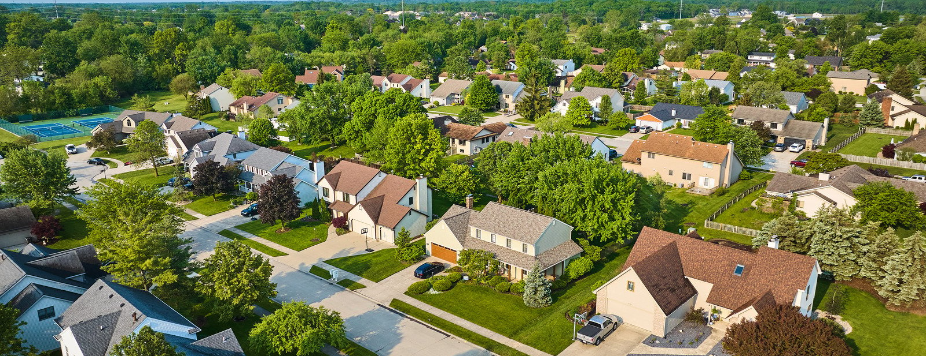
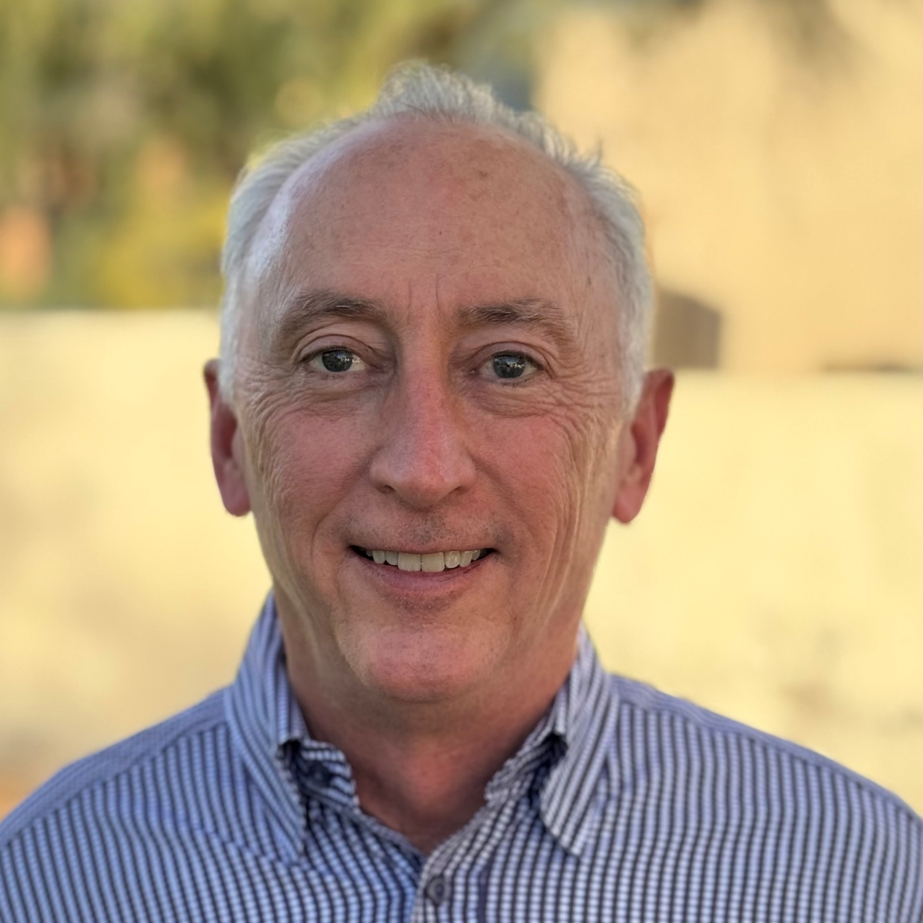
Clear Choice Fund,
LLC An Arizona Limited Liability Company
High Yield Fixed Income Investment
“Always Be Better” – build, measure, learn. Every day, every process.
This presentation is for informational purposes only and does not constitute an offer to sell or a solicitation of an offer to purchase securities. Any offer or solicitation will be made only through a Private Placement Memorandum (PPM) and is subject to the terms and conditions set forth therein. This material is intended solely for accredited investors as defined under Rule 501 of Regulation D of the Securities Act of 1933, as amended.
Investing in private securities involves significant risks, including the potential loss of your entire investment. Past performance is not indicative of future results. This presentation contains forward-looking statements, which are subject to uncertainties and risks that could cause actual results to differ materially. Prospective investors should conduct their own independent due diligence, review the PPM, and consult with their financial, legal, and tax advisors before making an investment decision.
Securities offered through this offering are not registered under the Securities Act of 1933, the Securities Exchange Act of 1934, or any state securities laws and are offered under applicable exemptions. These securities are illiquid and may not be resold or transferred without compliance with applicable securities laws.
Michael Coffman
President
2

Slide 3




Investing in What We Know:
At Clear Choice Fund, we stick to what works short-term, secured loans for residential real estate markets.
Welcome to Clear Choice Fund
A Time-Tested Approach:
We’ve built a business on disciplined lending practices, strong borrower relationships, and a commitment to risk mitigation.
A Conservative Model:
We avoid unnecessary complexity. No leverage. No shortcuts. Just solid returns and sound investments in vibrant markets.
3

Slide 4




Focused Markets
Growing Markets:
The West is one of the fastest-growing areas in the country, attracting businesses and residents alike.
Stable Demand:
Housing demand remains strong due to favorable demographics, job growth, and immigration.
Our Focus:
We specialize in single-family, non-owner-occupied properties, where opportunities abound.
4

Slide 5



Strong Borrower Relationships
Speed And Efficiency
Experience And Reliability
We close loans quickly so borrowers can act fast on their opportunities.
Decades of experience make us a trusted partner in real estate financing.
Repeat Borrower Relationships
Clear Communication
Borrowers return because they value our transparency and reliability.
Straightforward terms and open dialogue make the process seamless.
Borrower Review
“Exceptional experience with Clear Choice Fund. The team’s expertise and commitment to their clients are second to none." Ed P.
5

Slide 6
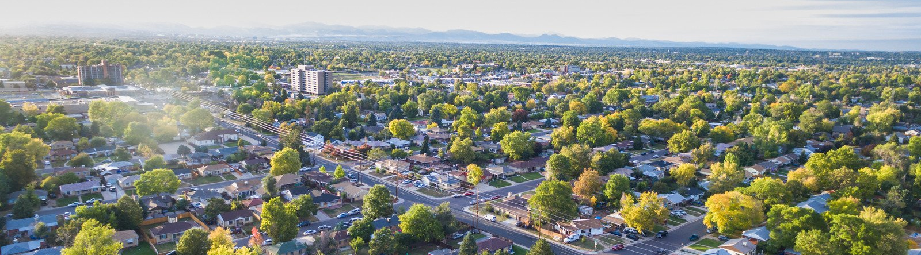
Disciplined Approach:
Protecting Investments:
Maximum 70% Loan-to-Value (LTV).
Maximum 80% of Purchase Price.
First Position Only.
Secured by Title Insurance and Property Insurance.
Focused exclusively on single-family, non-owner-occupied properties.
Lending Guidelines
Proven Results:
These guidelines have kept our portfolio strong. Thousands of loans and we have never missed our numbers.
6

Slide 7
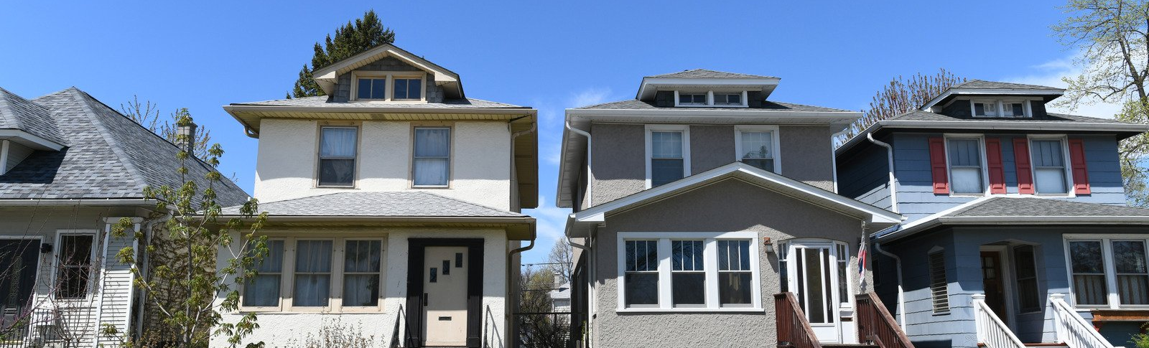

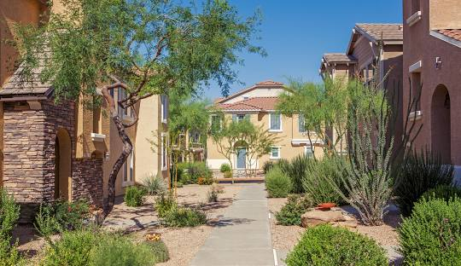
No Leverage
A Safer Model
Unlike leveraged funds, Clear Choice Fund is funded entirely by investors, with no bank debt.
Protecting Investor Capital
In a leveraged fund, the banks get paid first
Bank Control Avoided
No banks dictating terms, stopping funding, or requiring buybacks under pressure.
Transparency And Trust
What you see is what you get-”investor equity is never diluted by leverage.”
7

Slide 8

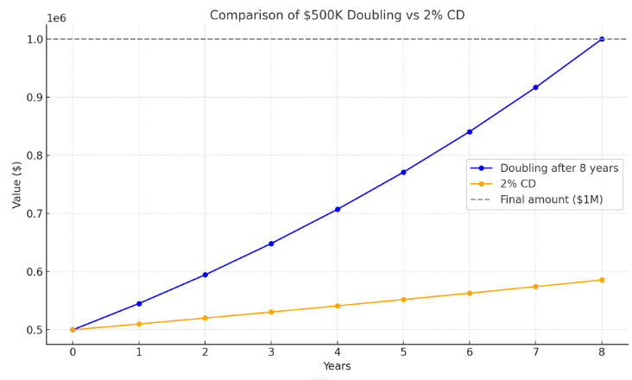
Stable, High Returns
Offering 9% annual yield on a two-year note—far exceeding traditional banking products. 9.45% return when compounded monthly.
Investor Benefits
The Power of 9%
Your money doubles in just 8 years (Rule of 72). Example: A $500,000 investment grows to $1,000,000 in only 8 years, secured by Arizona residential real estate.
Security You Can Trust
Loans backed by first-position deeds of trust, with comprehensive title and property insurance.
Passive Income, No Hassle
Enjoy high yields without the headaches of managing tenants or property.
Diversification Away from Volatility
Escape the turbulence of the stock market with a tangible, asset-backed investment.
8

Slide 9

Risk Management
Proven Safeguards
Track Record
Market Expertise
Aligned Interests
Strict underwriting criteria. Focused portfolio of short-term loans.
Thousands of loans completed with low default rates and consistent performance.
Decades of experience navigating real estate cycles.
We don’t take risks we wouldn’t accept ourselves. We are stewards of our investors funds and do not take that responsibility lightly
9

Slide 10

Investor Testimonials
Confidence In Results:
“I’ve been investing with Clear Choice Fund for ten years and couldn’t be happier. Their communication and returns are excellent.”—John F., Investor.
“Clear Choice Fund delivers consistent results. I trust them with my capital.”—Mary R., Investor.
Repeat Investors:
Most of our investors return year after year, a testament to the strength of our model.
Clear Choice Fund
10

Slide 11
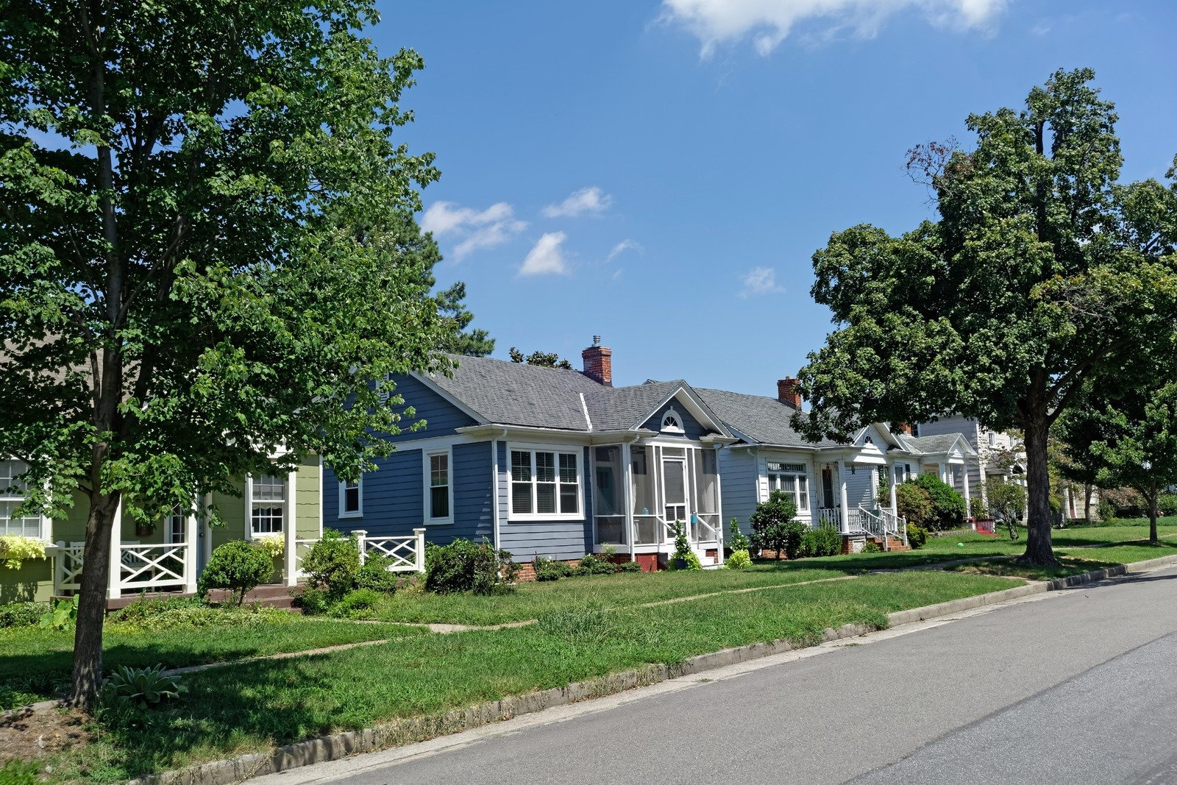
Contact Clear Choice Fund
Receive Investor Documentation
Execute Investor Documentation
Wire Funds
Start earning interest
Receive your General Obligation Note
Become an Investor
Receive monthly statements
Receive Portfolio Reports
11

Slide 12

Let’s Talk
Don’t delay. Whether with Clear or somewhere else, get your money out working for you. And remember that Rule of 72! Please reach out now.
Phone | 480-777-1230
Mail | mike@clearaz.com
Address | 9399 S Priest Drive Tempe, AZ 85284
12

